Slide 1
PREDICTIONS IN PUBLIC
A QUANTITATIVE UNDERSTANDING OF COMMUNITY MEMBERS' COMPREHENSION AND USE OF BUSHFIRE.
Dr Amy Griffin
Senior Lecturer
RMIT University
Natural Hazards Research Australia
amy.griffin@rmit.edu.au
Dr Paula Dootson
Associate Professor
Queensland University of Technology
Natural Hazards Research Australia
paula.dootson@qut.edu.au
Deana Pullella
Team Leader Public Information | Media and Corporate Communications
Department of Fire and Emergency Services, Western Australia
deana.pullella@dfes.wa.gov.au
© Natural Hazards Research Australia 2023
Notes:
Acknowledgement
Thank SteerCo

Slide 2
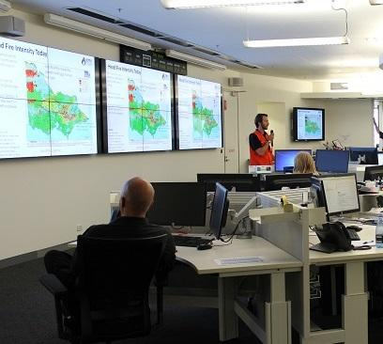
Project Aims
to use empirical evidence and collaborative processes to contribute to a national approach to the future use of public-facing predictive fire spread products during an emergency.
Notes:
The aim of the project is…

Slide 3
Project Team
Coordinators
Chloe Begg (CFA)
Angela Gardner (Vic Dept. Edu.)
Research Team
Paula Dootson (QUT)
Amy Griffin & Erica Kuligowski (RMIT University)
Timothy Neale (Deakin University)
Graham Dwyer (Swinburne)
Notes:
To achieve this, we have a large project team…

Slide 4
Project Team
Project Steering Committee:
Representatives from AFAC PSG and AFAC WG from each Australian jurisdiction.
TAS - Chris Collins (PSG) and Heather Stewart (previously Peter Middleton) (WG)
WA - Jackson Parker (PSG) and Anni Fordham/Deana Pullella (WG)
QLD - Jack Emeleus/Mandy Price (PSG) David Dumsday (WG)
NSW - Laurence McCoy/David Field (PSG) and Ben Shepherd (WG)
VIC - Phillip Brien (PSG) and Reegan Key/Marc Unsworth (WG)
ACT- Ailish Milner/Ryan Lawery (PSG) and Leighton Bush (previously James Morris) (WG)
SA - Simeon Telfer (previously Mike Wouters) (PSG) and Monique De Silva (WG)
NT - Don MacCorquodale and Angus Farlam (previously Akshy Athukorala)
BOM – Carla Mooney (previously Fiona Dunstan)
Notes:
We also have a project steering committee. This committee is made up of PSG and WG representatives from all Australian jurisdictions. This committee is responsible for providing feedback, assisting with and approving decision-making related to the project’s scope and practical outputs.

Slide 5
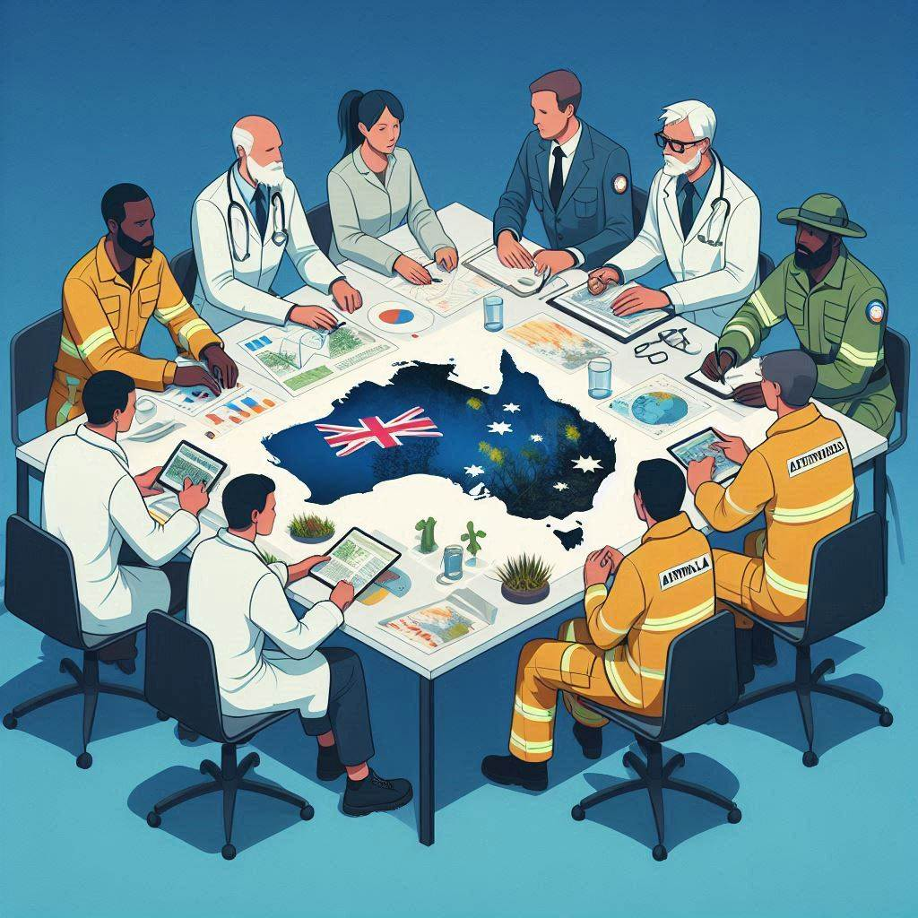
Project design:
Collaborative
Iterative
Human-centred
Design should account for the public's needs & EM organisations' needs
Generating evidence is insufficient
Project Design
Research should be made available to inform EM practice and decision-making.
Competing priorities and timelines between researchers and EM personnel = limited involvement from end users.
Research tends to simplify complex problems to enable rigorous study and generalisable results.
This can lead to a gap between research and practice.
Notes:
The project has been broken down into 3 phases. Phase 1 has been completed. We spent most of last year conducting research to help us better understand the status quo. We wanted to understand current agency practice as well as community comprehension and use of existing public-facing map-based products.
Phase 2 is underway, and we have spent this year working with the SC to develop a set of map concepts to test with community members.
Paula and I will present on findings from both Phase 1 and 2 of our study today.
Based on the findings of this research we will turn our attention in phase 3 to the development of practical outputs for agency use. We have already defined one of the practical outcomes, which I will speak to in a moment, but we also have funding to develop 2 additional practical outputs. These outputs will be developed together with the research team and the project SC.

Slide 6
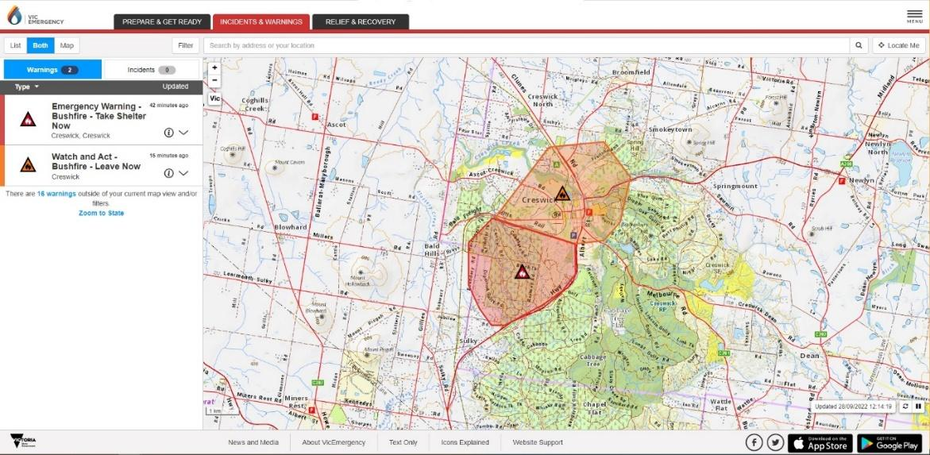
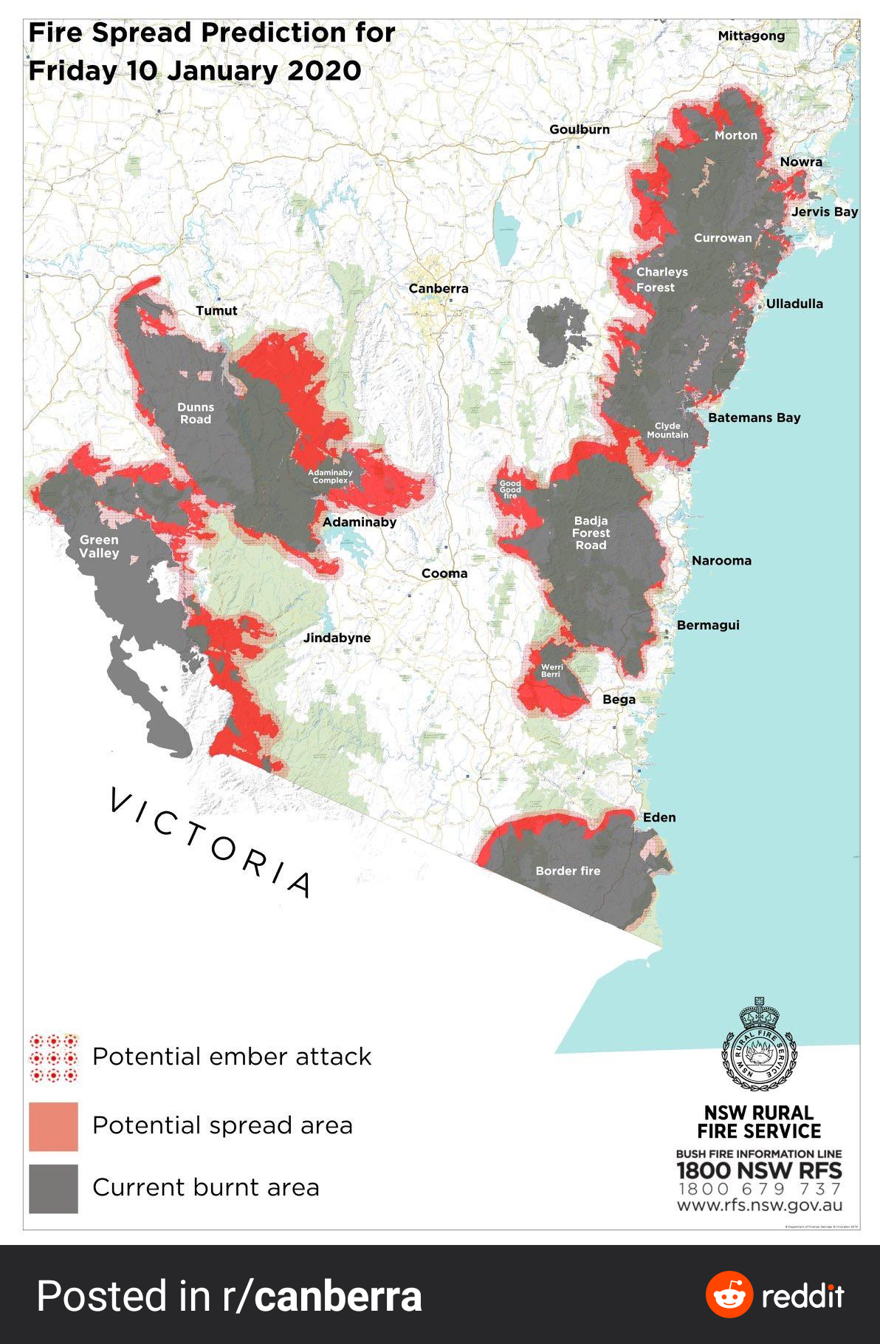
Project Design
Phase 1:
Understanding current agency practice and community comprehension and use of existing public-facing map-based products (i.e., incident warning maps and fire spread prediction maps). [WP1-5]
Phase 2:
Developing and testing public-facing fire spread prediction map concepts. [WP7-12]
Phase 3:
Developing practical outputs for agency use.
Notes:
The project has been broken down into 3 phases. Phase 1 has been completed. We spent most of last year conducting research to help us better understand the status quo. We wanted to understand current agency practice as well as community comprehension and use of existing public-facing map-based products.
Phase 2 is underway, and we have spent this year working with the SC to develop a set of map concepts to test with community members.
Paula and I will present on findings from both Phase 1 and 2 of our study today.
Based on the findings of this research we will turn our attention in phase 3 to the development of practical outputs for agency use. We have already defined one of the practical outcomes, which I will speak to in a moment, but we also have funding to develop 2 additional practical outputs. These outputs will be developed together with the research team and the project SC.

Slide 7
Research Method
[WP5]
Survey: online, recruited via Qualtrics
Sample size: N= 3007 across all States and Territories
Maps: 13 incident maps (2 x 7 jurisdictions); 1 fire spread prediction map
Scenario: a co-designed bushfire event
Communication: maps + warning text; each in their own format
Notes:
Co-designed

Slide 8
Scenario
It’s January school holidays and you and your family are spending the week at your holiday home in the picturesque town of Eagle Bay in Western Australia’s south-west region. It’s a typical WA summer, with daily temperatures in the high 30s with hot, gusty afternoon winds. It’s late at night when you start to see the distinct glow of a bushfire in the near distance. You look up the state’s official emergency information website – Emergency WA – and see the following warnings and maps.
Notes:
DESIGN INSTRUCTIONS:
Add images to each of these boxes by clicking on the image icon and selecting a source.
If removing one or more of the image boxes, ensure that the image edges remain balanced (horizontally and vertically) with each other.

Slide 9
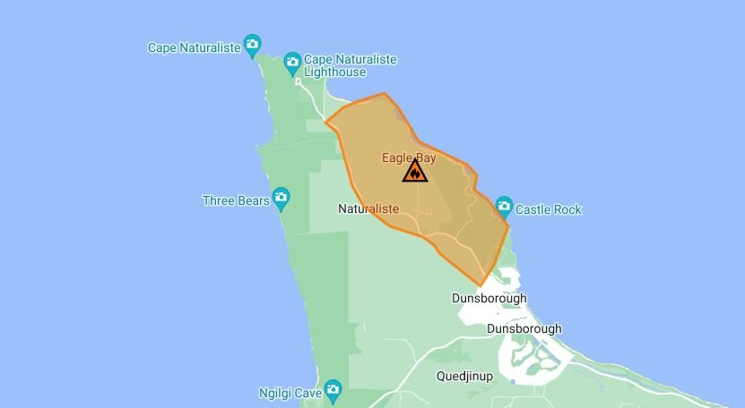
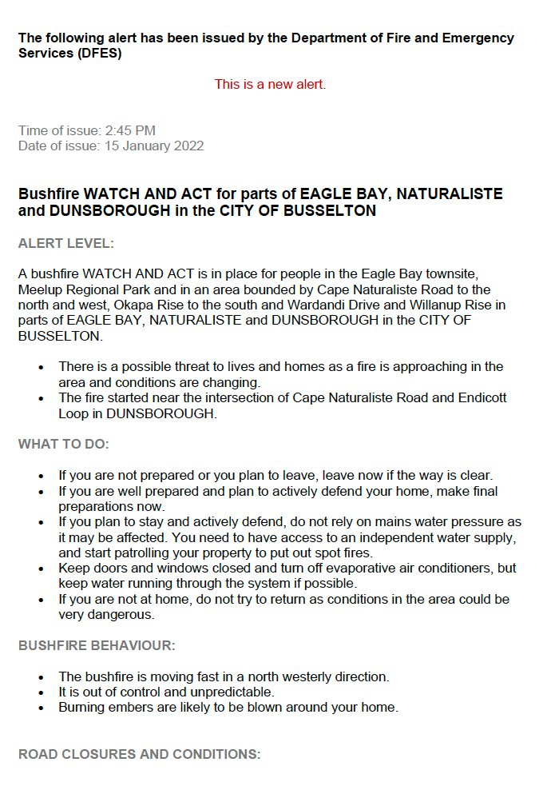
Scenario + Map 1
It’s January school holidays and you and your family are spending the week at your holiday home in the picturesque town of Eagle Bay in Western Australia’s south-west region. It’s a typical WA summer, with daily temperatures in the high 30s with hot, gusty afternoon winds. It’s late at night when you start to see the distinct glow of a bushfire in the near distance. You look up the state’s official emergency information website – Emergency WA – and see the following warnings and maps.
Notes:
DESIGN INSTRUCTIONS:
Add images to each of these boxes by clicking on the image icon and selecting a source.
If removing one or more of the image boxes, ensure that the image edges remain balanced (horizontally and vertically) with each other.

Slide 10
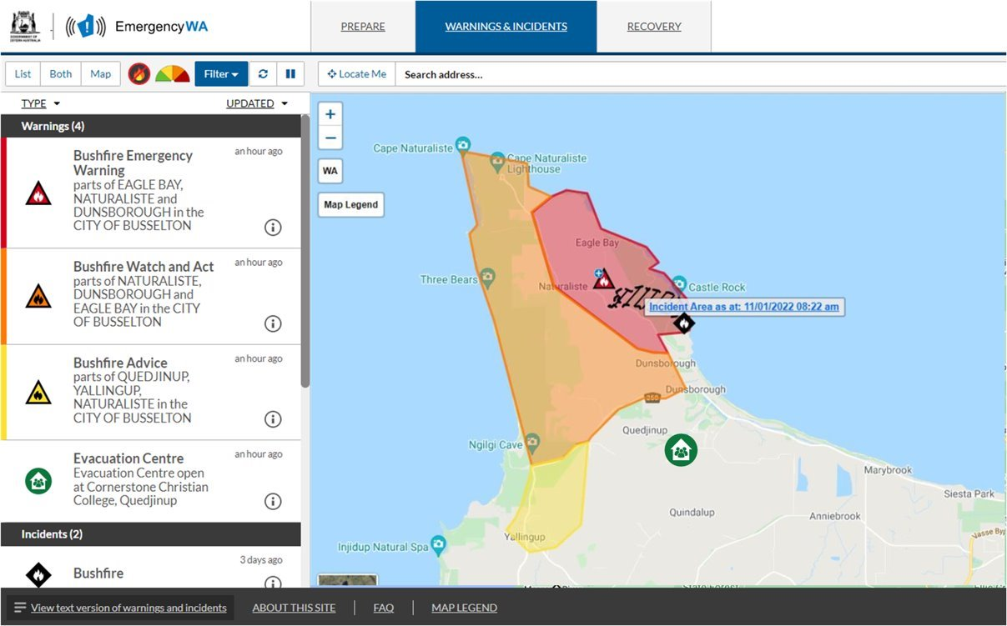
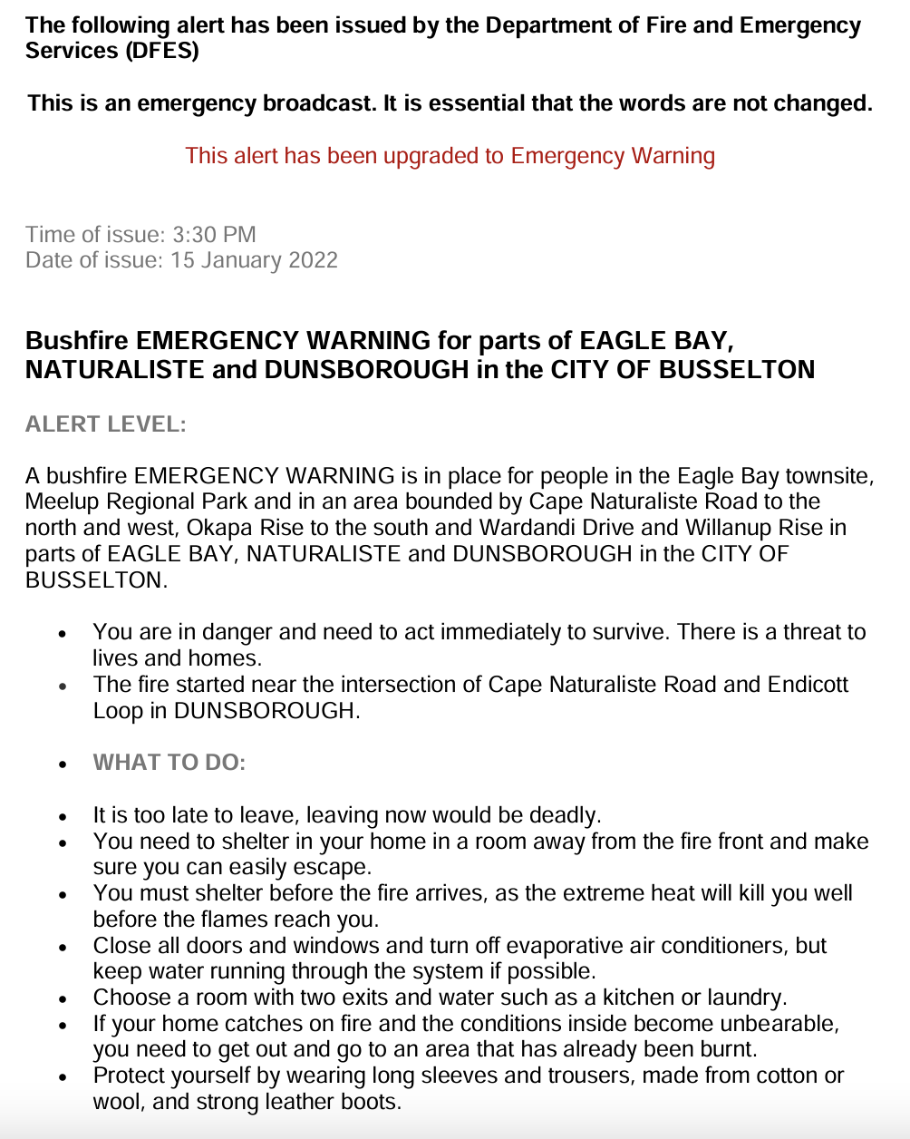
Scenario + Map 2
It’s January school holidays and you and your family are spending the week at your holiday home in the picturesque town of Eagle Bay in Western Australia’s south-west region. It’s a typical WA summer, with daily temperatures in the high 30s with hot, gusty afternoon winds. It’s late at night when you start to see the distinct glow of a bushfire in the near distance. You look up the state’s official emergency information website – Emergency WA – and see the following warnings and maps.
Notes:
DESIGN INSTRUCTIONS:
Add images to each of these boxes by clicking on the image icon and selecting a source.
If removing one or more of the image boxes, ensure that the image edges remain balanced (horizontally and vertically) with each other.

Slide 11
Who was in the study?
 | National | QLD | NSW/ ACT | VIC | TAS | SA | WA | NT
N | 3007 | 415 | 421 | 417 | 243 | 404 | 1015* | 94
Sex | 52.7% F | 58% F | 54% F | 65% F | 55% F | 59% F | 40.9% F | 57.4% F
Aged 18-44 | 51% | 53% | 55% | 54% | 43% | 39.4% | 53.6% | 66%
Bushfire < 5 years | 34.1% | 29% | 48% | 24% | 33% | 21.3% | 37% | 58.5%
Map use | 42.7% | 30% | 49% | 45% | 40% | 43% | 42.7% | 63%
Agency/ Vol exp. | 10.8% | 12% | 9.7% | 9.6% | 12.8% | 9.7% | 10.7% | 18%
Mod home / property | 21.5% | 22% | 18.5% | 19% | 24.7% | 17.6% | 22% | 47%
Notes:
DESIGN INSTRUCTIONS:
Add images to each of these boxes by clicking on the image icon and selecting a source.
If removing one or more of the image boxes, ensure that the image edges remain balanced (horizontally and vertically) with each other.

Slide 12
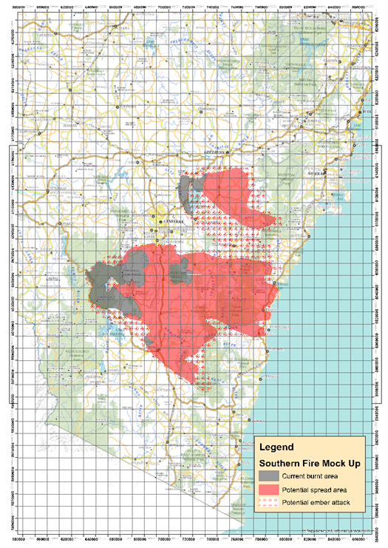
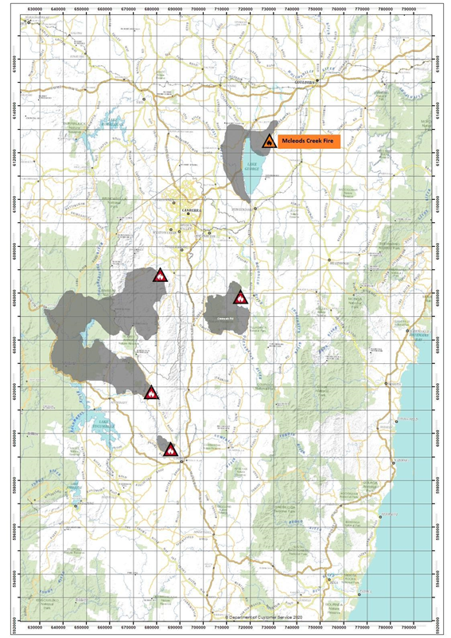
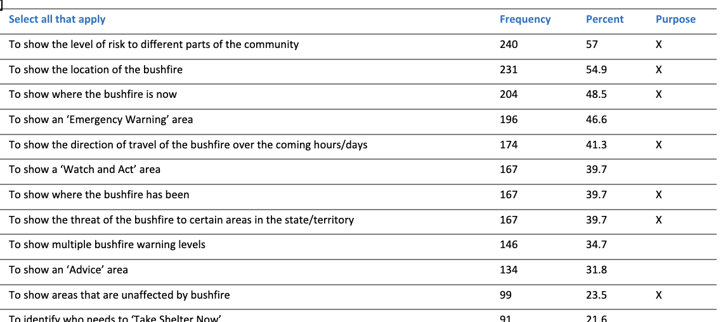
Comprehension
Points of confusion for incident maps:
map contained multiple polygons and warning levels,
when it was hard to locate oneself on the map due to the design of the map such as too many roads and no road names or the map was too bare, with limited geographical information
didn't know enough about bushfires
What do you understand this to be? Example responses:
A map showing where the fire is and the potential spread and possible ember attacks.
A more detailed map showing where the current fires are, where they could spread, and risk from ember falling.
Notes:
Comprehension of the map and associated warning message
Respondents indicated some comprehension of the intended purpose of the maps and associated warning messages as well as the intended prompted action. There were some points of confusion, including when the map contained multiple polygons and warning levels, when the respondent was placed outside the polygon, and when it was hard to locate oneself on the map due to the design of the map such as too many roads and no road names or the map was too bare, with limited geographical information. Forthcoming research, in the next phase of the research program, will examine how comprehension is impacted by using different concepts in a map (like the ones mentioned above) to communicate the risk and uncertainty of the event, of which the results will guide map design in practice.

Slide 13
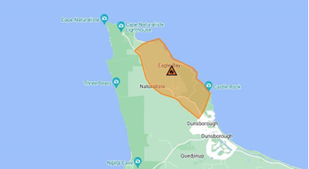
Risk perceptions and negative emotions
Increased when the map and message represented a higher level of threat escalation.
Watch and Act --> Emergency Warning
Notes:
Risk perceptions and emotions elicited with the map and associated warning message
Overall, both risk perceptions and negative emotions tended to increase when the map and associated warning message were visualising and describing a higher level of threat escalation. For example, Map 1 may have been a ‘Watch and Act’ level of bushfire warning whereas Map 2 may have been an ‘Emergency Warning’ level of bushfire warning, a higher level of escalation under the Australian Warning System. Map 2 was thus associated with stronger self-reported risk perceptions and negative emotions, congruent with the higher level of warning escalation.
However, conflicting results were also found. For instance, if the warning level in the associated warning message did not change for both maps tested (e.g., both maps shown to the respondent were ‘Watch and Act’ level warnings), we saw evidence of an increase in risk perceptions and heightened negative emotions with the addition of a polygon highlighting a new bushfire impacted area (Figure 1). In contrast, when an additional polygon was present, visualising two areas impacted by the bushfire, but the associated warning for each map was different, then the higher perceptions of risk and negative emotions appeared reflective of the level of warning not the number of polygons on the map (Figure 2). Future research needs to consider which is more salient in the public’s interpretation of risk and the elicited negative emotions: the polygons in the map or the warning message.

Slide 14
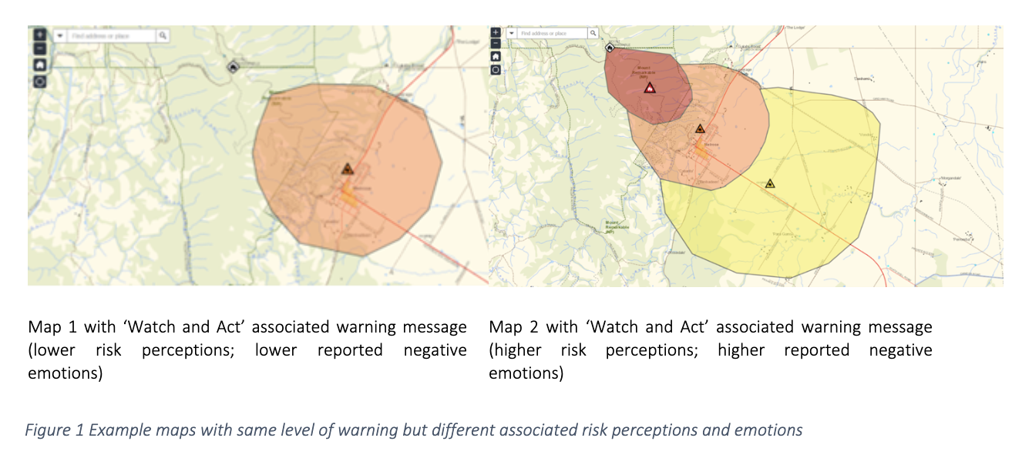
Risk perceptions and negative emotions
Notes:
Risk perceptions and emotions elicited with the map and associated warning message
Overall, both risk perceptions and negative emotions tended to increase when the map and associated warning message were visualising and describing a higher level of threat escalation. For example, Map 1 may have been a ‘Watch and Act’ level of bushfire warning whereas Map 2 may have been an ‘Emergency Warning’ level of bushfire warning, a higher level of escalation under the Australian Warning System. Map 2 was thus associated with stronger self-reported risk perceptions and negative emotions, congruent with the higher level of warning escalation.
However, conflicting results were also found. For instance, if the warning level in the associated warning message did not change for both maps tested (e.g., both maps shown to the respondent were ‘Watch and Act’ level warnings), we saw evidence of an increase in risk perceptions and heightened negative emotions with the addition of a polygon highlighting a new bushfire impacted area (Figure 1). In contrast, when an additional polygon was present, visualising two areas impacted by the bushfire, but the associated warning for each map was different, then the higher perceptions of risk and negative emotions appeared reflective of the level of warning not the number of polygons on the map (Figure 2). Future research needs to consider which is more salient in the public’s interpretation of risk and the elicited negative emotions: the polygons in the map or the warning message.

Slide 15
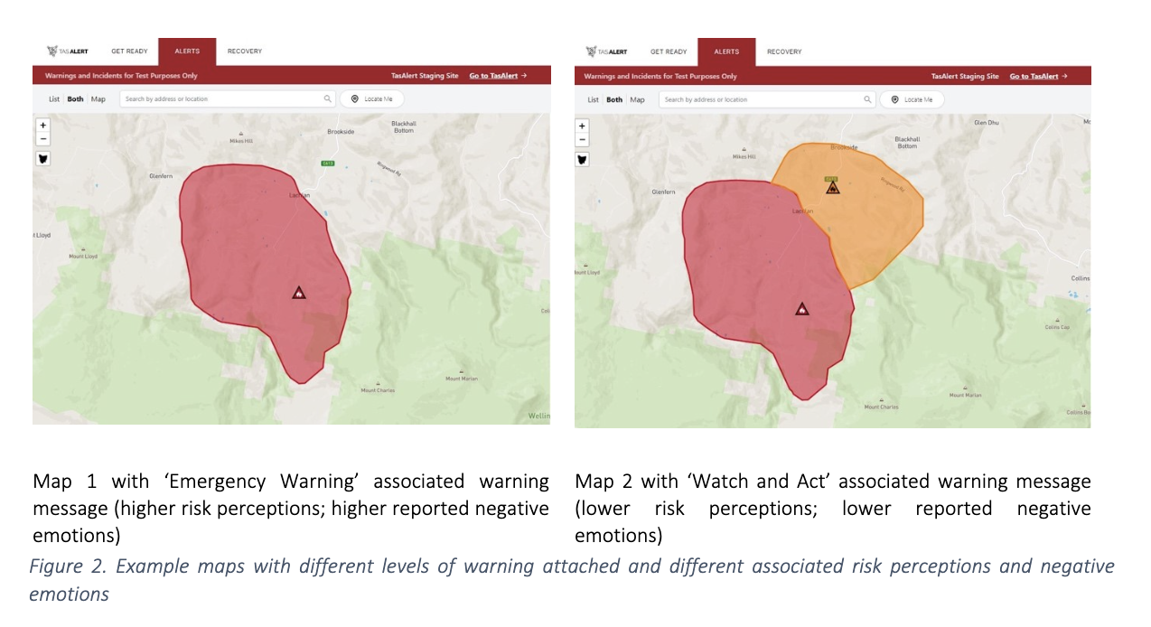
Risk perceptions and negative emotions
Notes:
Risk perceptions and emotions elicited with the map and associated warning message
Overall, both risk perceptions and negative emotions tended to increase when the map and associated warning message were visualising and describing a higher level of threat escalation. For example, Map 1 may have been a ‘Watch and Act’ level of bushfire warning whereas Map 2 may have been an ‘Emergency Warning’ level of bushfire warning, a higher level of escalation under the Australian Warning System. Map 2 was thus associated with stronger self-reported risk perceptions and negative emotions, congruent with the higher level of warning escalation.
However, conflicting results were also found. For instance, if the warning level in the associated warning message did not change for both maps tested (e.g., both maps shown to the respondent were ‘Watch and Act’ level warnings), we saw evidence of an increase in risk perceptions and heightened negative emotions with the addition of a polygon highlighting a new bushfire impacted area (Figure 1). In contrast, when an additional polygon was present, visualising two areas impacted by the bushfire, but the associated warning for each map was different, then the higher perceptions of risk and negative emotions appeared reflective of the level of warning not the number of polygons on the map (Figure 2). Future research needs to consider which is more salient in the public’s interpretation of risk and the elicited negative emotions: the polygons in the map or the warning message.

Slide 16
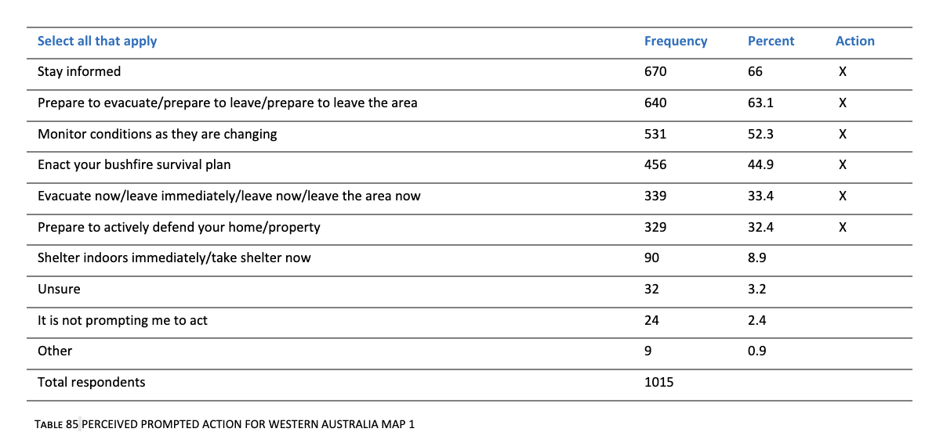
Protective Action - Comprehension
What do you think this is prompting you do to?
Notes:
Protective action intentions associated with the map and warning message
When evaluating the top five actions that respondents indicated they would take in response to viewing the map and associated warning message, the national sample was largely compliant with the agency-issued instructions, which could be attributed to the fact that clear instructions were provided in the associated warning messages. This insight arguably reinforces the notion that maps are a tool to support instructional warnings, rather than tool in and of itself to guide protective action.
However, worth noting were reports of additional actions respondents indicated they may take beyond what was explicitly instructed by the fire agency, which fell into one of three possible categories: (1) a general instruction, e.g., stay informed by emergency services agencies, which was not explicitly mentioned but largely implied by the map and associated warning message; (2) a specific action that was not explicitly mentioned but would still help protect the lives and property of the affected individual; or (3) a specific action that was not explicitly mentioned in the map and or associated warning message and where following that action could potentially put the individual (or their property) at risk (e.g., waiting for a firefighter to tell them to evacuate, waiting for police to knock on the door). These undesired deviations in category three are best addressed at the community level through education or explicitly in warnings (e.g., “do not expect a firefighter at your door”).

Slide 17
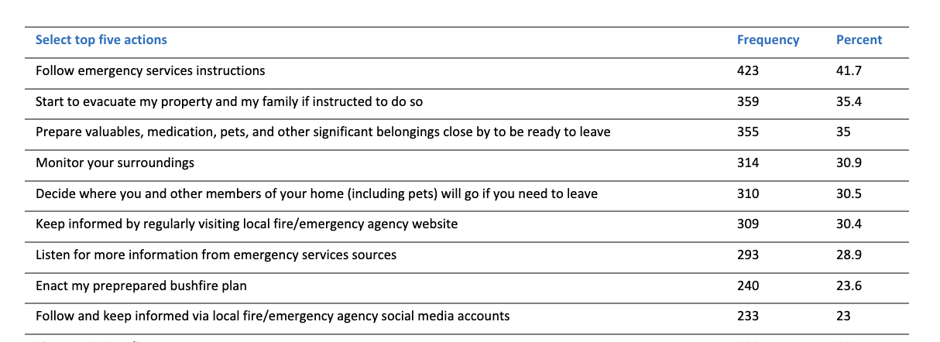
Protective Action - Intentions
Notes:
worth noting were reports of additional actions respondents indicated they may take beyond what was explicitly instructed by the fire agency, which fell into one of three possible categories: (1) a general instruction, e.g., stay informed by emergency services agencies, which was not explicitly mentioned but largely implied by the map and associated warning message; (2) a specific action that was not explicitly mentioned but would still help protect the lives and property of the affected individual; or (3) a specific action that was not explicitly mentioned in the map and or associated warning message and where following that action could potentially put the individual (or their property) at risk (e.g., waiting for a firefighter to tell them to evacuate, waiting for police to knock on the door). These undesired deviations in category three are best addressed at the community level through education or explicitly in warnings (e.g., “do not expect a firefighter at your door”).

Slide 18
Protective Action - Intentions
a general instruction, e.g., stay informed by emergency services agencies, which was not explicitly mentioned but largely implied by the map and associated warning message;
a specific action that was not explicitly mentioned but would still help protect the lives and property of the affected individual; or
a specific action that was not explicitly mentioned in the map and or associated warning message and where following that action could potentially put the individual (or their property) at risk (e.g., waiting for a firefighter to tell them to evacuate, waiting for police to knock on the door).
Notes:
worth noting were reports of additional actions respondents indicated they may take beyond what was explicitly instructed by the fire agency, which fell into one of three possible categories: (1) a general instruction, e.g., stay informed by emergency services agencies, which was not explicitly mentioned but largely implied by the map and associated warning message; (2) a specific action that was not explicitly mentioned but would still help protect the lives and property of the affected individual; or (3) a specific action that was not explicitly mentioned in the map and or associated warning message and where following that action could potentially put the individual (or their property) at risk (e.g., waiting for a firefighter to tell them to evacuate, waiting for police to knock on the door). These undesired deviations in category three are best addressed at the community level through education or explicitly in warnings (e.g., “do not expect a firefighter at your door”).

Slide 19
Fire spread prediction map
Follow emergency services instructions​
Prepare valuables, medication, pets, and other significant belongings close by to be ready to leave​
Start to evacuate my property and my family if instructed to do so​
​variations on 'stay informed'
Notes:
Follow emergency services instructions
Prepare valuables, medication, pets, and other significant belongings close by to be ready to leave
Start to evacuate my property and my family if instructed to do so

Slide 20
Common feedback for all incident maps
Directionality of hazard: use arrows showing directionality of the bushfire spread.
Legend: use a legend or key to help interpret the information presented on the map.
Timing: indicate when the map was developed and for how long it is valid; time estimates on how fast it is tracking.
Landmarks: show on the map key landmarks, including evacuation centres, to help people locate themselves on the map.
Routes: show clear routes out to help people navigate their evacuation.
Interactive capabilities: provide the ability to engage with the map directly, i.e., zoom functionality.
Sizing and legibility: increase the prominence of hazard markers alongside placenames, roadways, and other landmarks.
Colours: increase contrast of colours to clearly delineate multiple warning areas.
Notes:
DESIGN INSTRUCTIONS:
Add images to each of these boxes by clicking on the image icon and selecting a source.
If removing one or more of the image boxes, ensure that the image edges remain balanced (horizontally and vertically) with each other.

Slide 21
Research backs up key decision-making
Helps those in Public Information have critical conversations with Operational personnel
What we think vs what the public want may be worlds apart
Research should underpin and inform every key decision
What happens when the topic of risk arises?
e.g. WA example, publishing evacuation routes on a map has the perception of greater risk
Notes:
DESIGN INSTRUCTIONS:
Add images to each of these boxes by clicking on the image icon and selecting a source.
If removing one or more of the image boxes, ensure that the image edges remain balanced (horizontally and vertically) with each other.

Slide 22
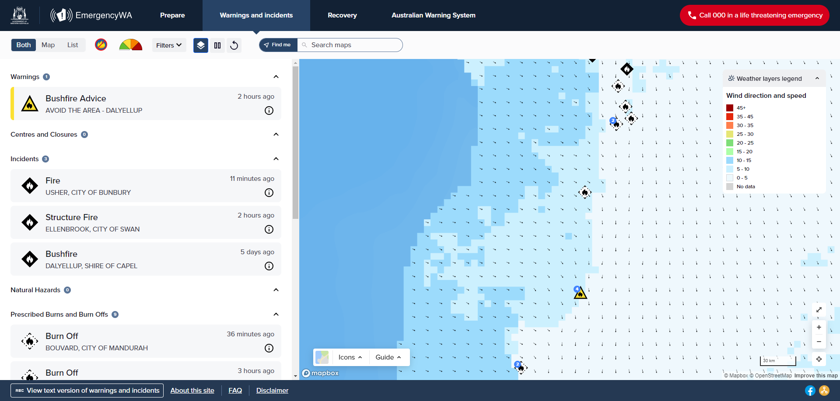
Emergency WA – features include...weather overlays
Notes:
DESIGN INSTRUCTIONS:
Add images to each of these boxes by clicking on the image icon and selecting a source.
If removing one or more of the image boxes, ensure that the image edges remain balanced (horizontally and vertically) with each other.

Slide 23
Where to from here...
xxx
Notes:
DESIGN INSTRUCTIONS:
Add images to each of these boxes by clicking on the image icon and selecting a source.
If removing one or more of the image boxes, ensure that the image edges remain balanced (horizontally and vertically) with each other.

Slide 24
Evidence-based principles
Six principles to help structure the design of the empirical studies:
Principle 1: Ensure there are clear triggers for predictive map production, dissemination, and updates.
Principle 2: Ensure that map readers can understand their location in relation to the hazard (self-localisation) and the information that is displayed on the map can support appropriate protective actions.
Principles 3: Ensure maps communicate risk and uncertainty.
Principle 4: Ensure predictive maps complement incident warning maps.
Principle 5: Ensure that maps are accessible to a wide range of audiences.
Principle 6: Ensure cross-border coordination regarding authorisation of map dissemination to the public.

Slide 25
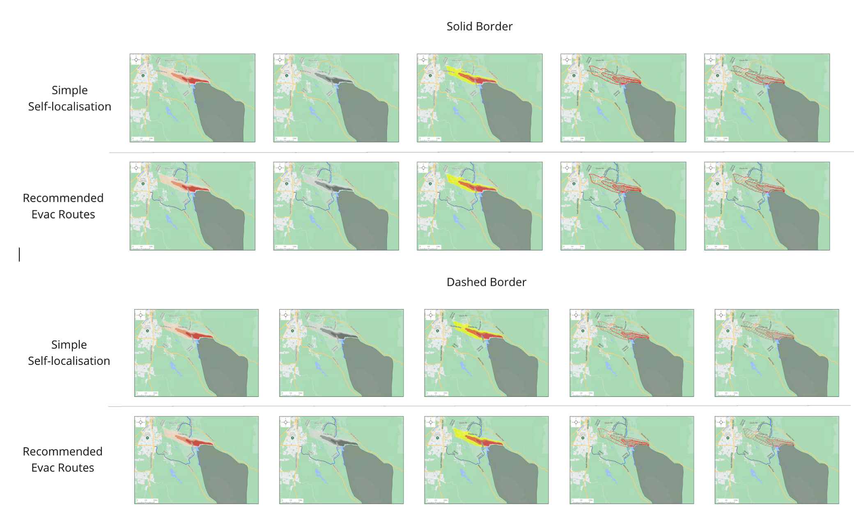
WP 9
Principles 2, 3
Notes:
Manipulations
Colour: AWS, red, grey
Texture: (Solid, Lightness, Dots, Hash)
Border: dashed, solid
Location: inside, outside
Evacuation: evac route, no evac route

Slide 26
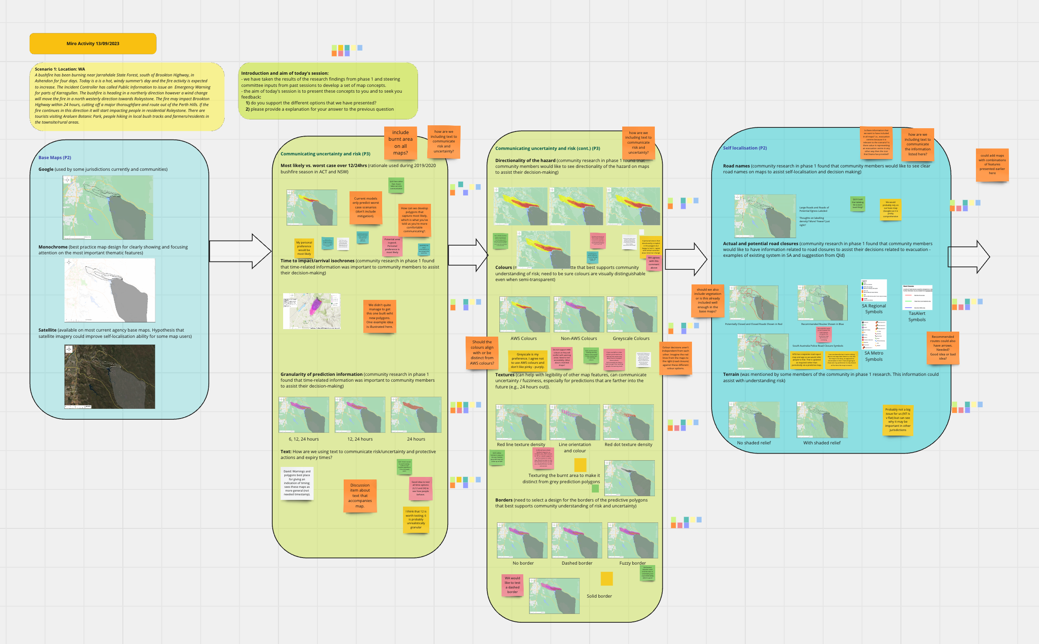

Slide 27
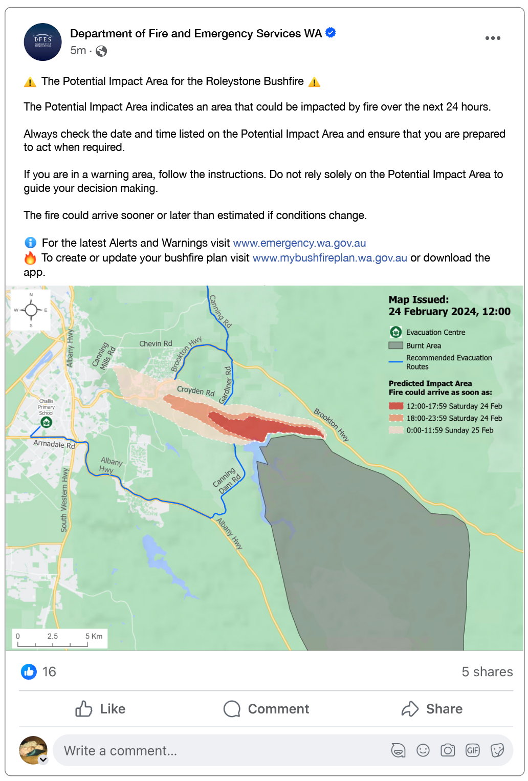
Design features informed by WP5 findings
Legend: use a legend or key to help interpret the information presented on the map.
Timing: indicate when the map was developed and for how long it is valid; time estimates on how fast it is tracking.
Landmarks: show on the map key landmarks, including evacuation centres, to help people locate themselves on the map.
Routes: show clear routes out to help people navigate their evacuation.
Sizing and legibility: increase the prominence of hazard markers alongside placenames, roadways, and other landmarks.
Colours: increase contrast of colours to clearly delineate multiple warning areas.

Slide 28
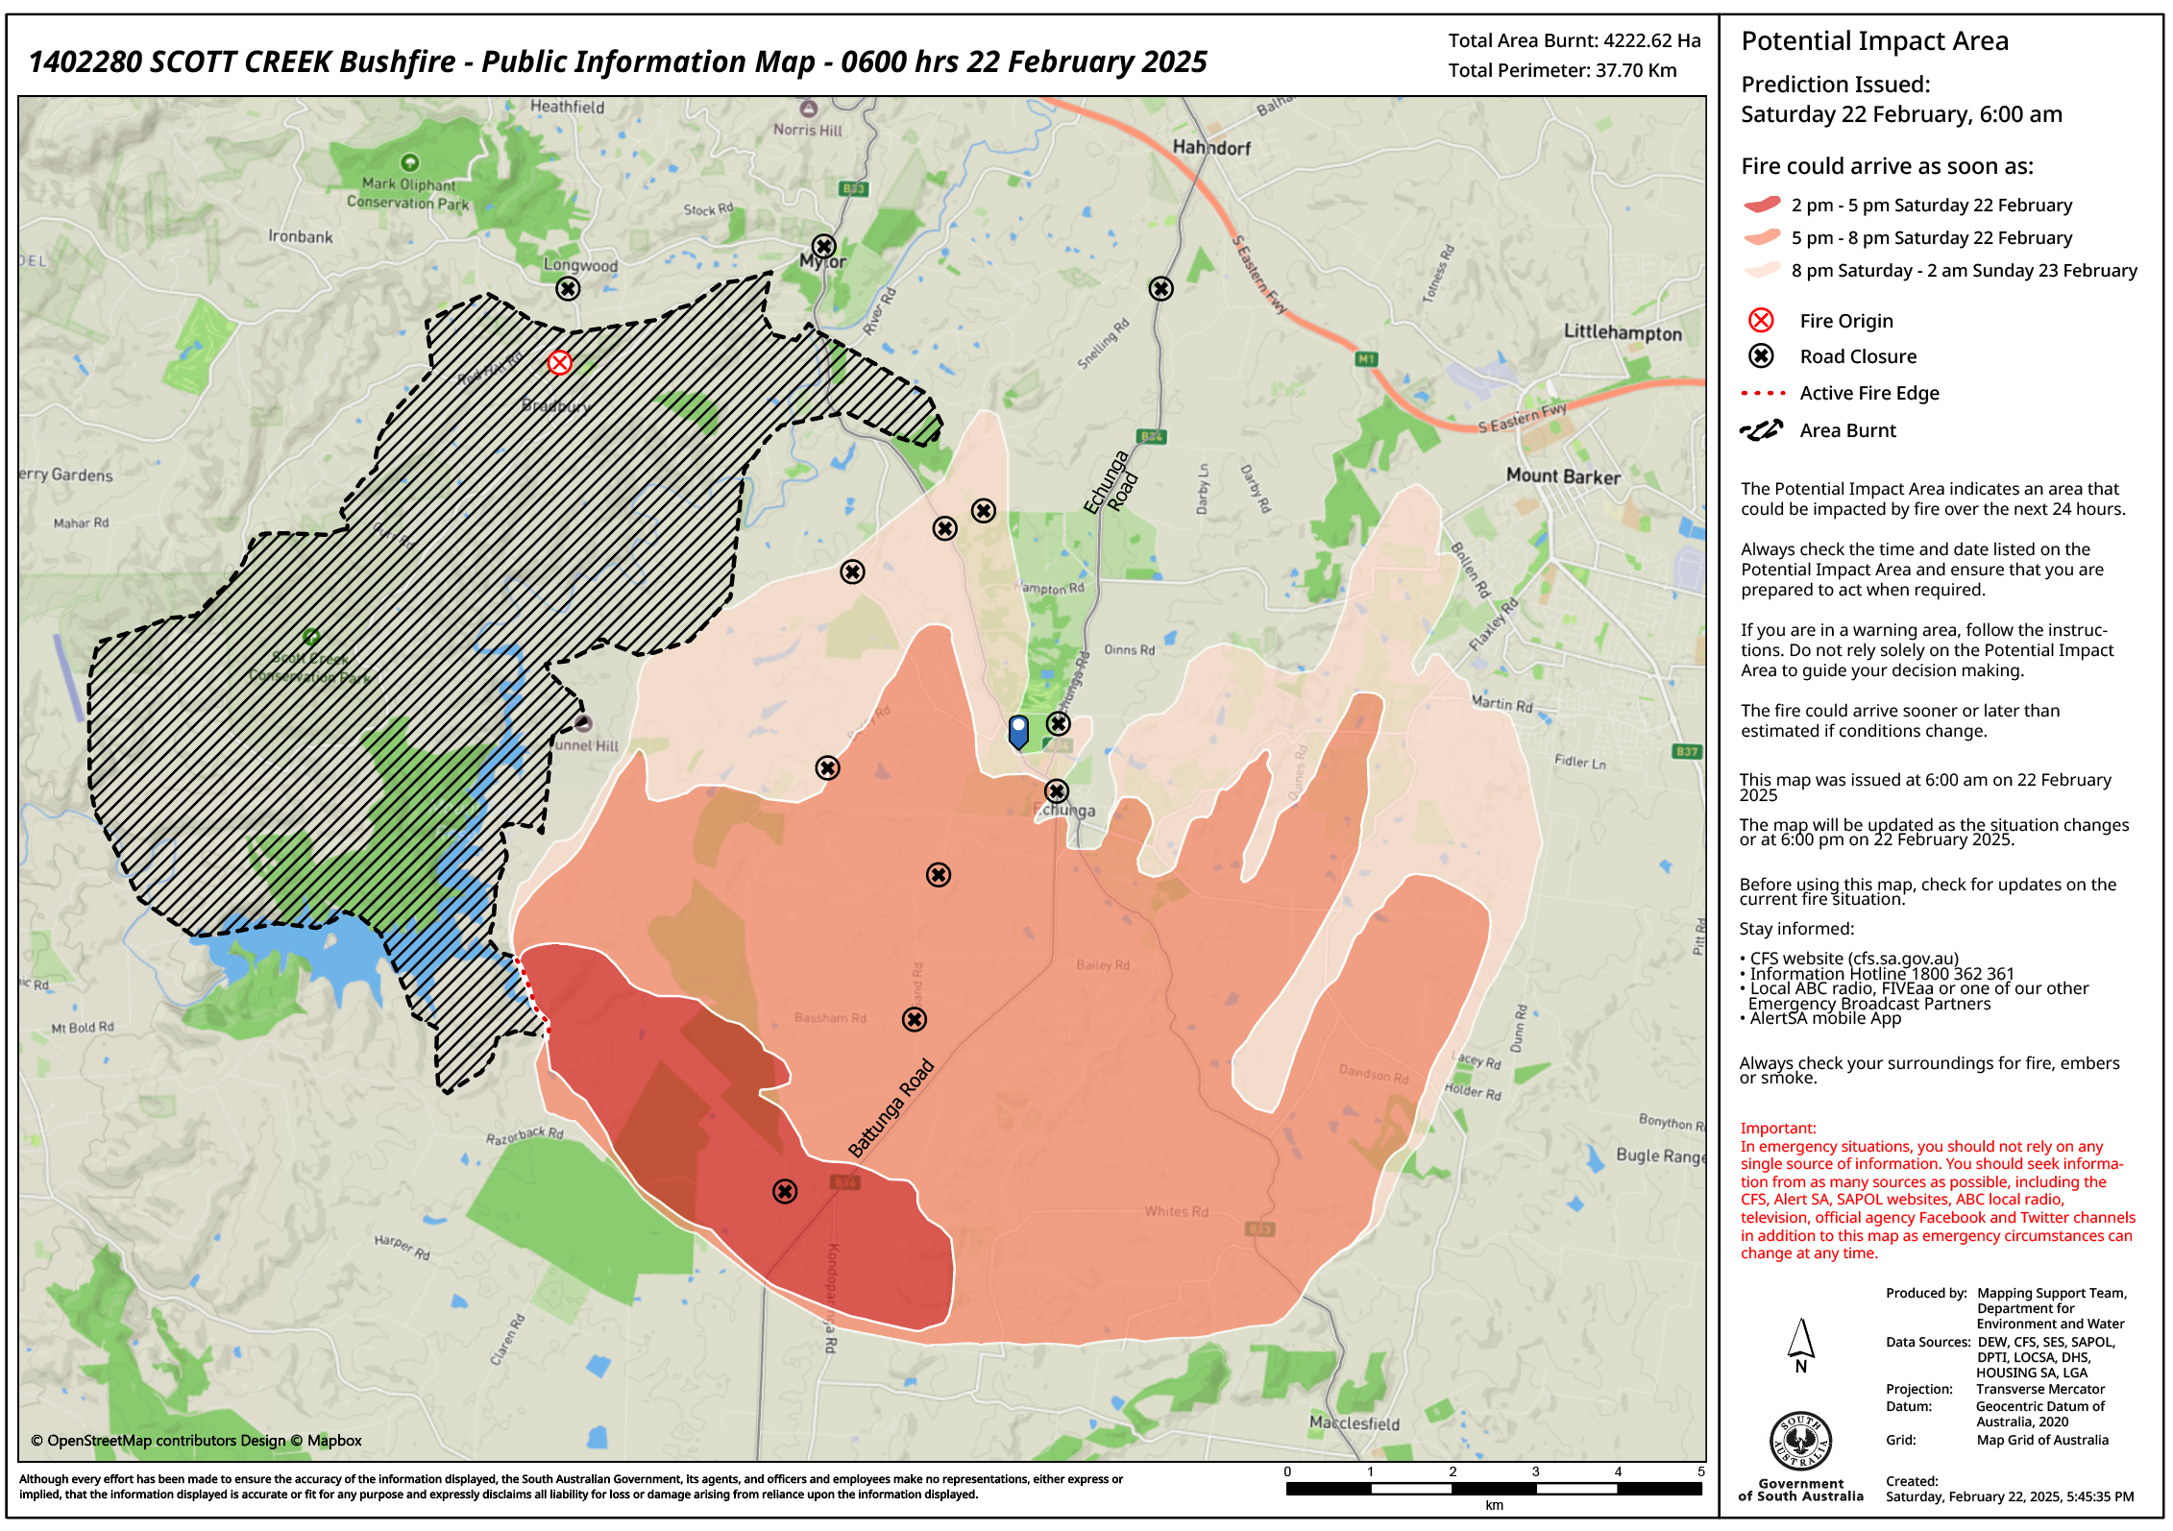
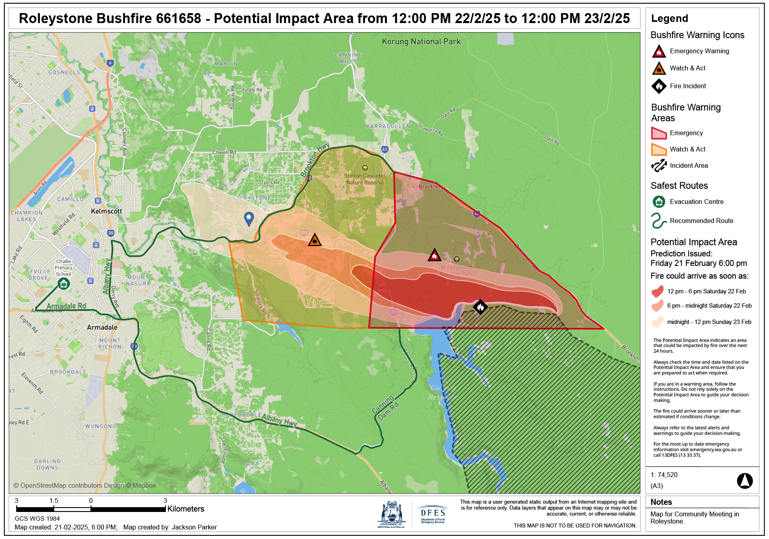
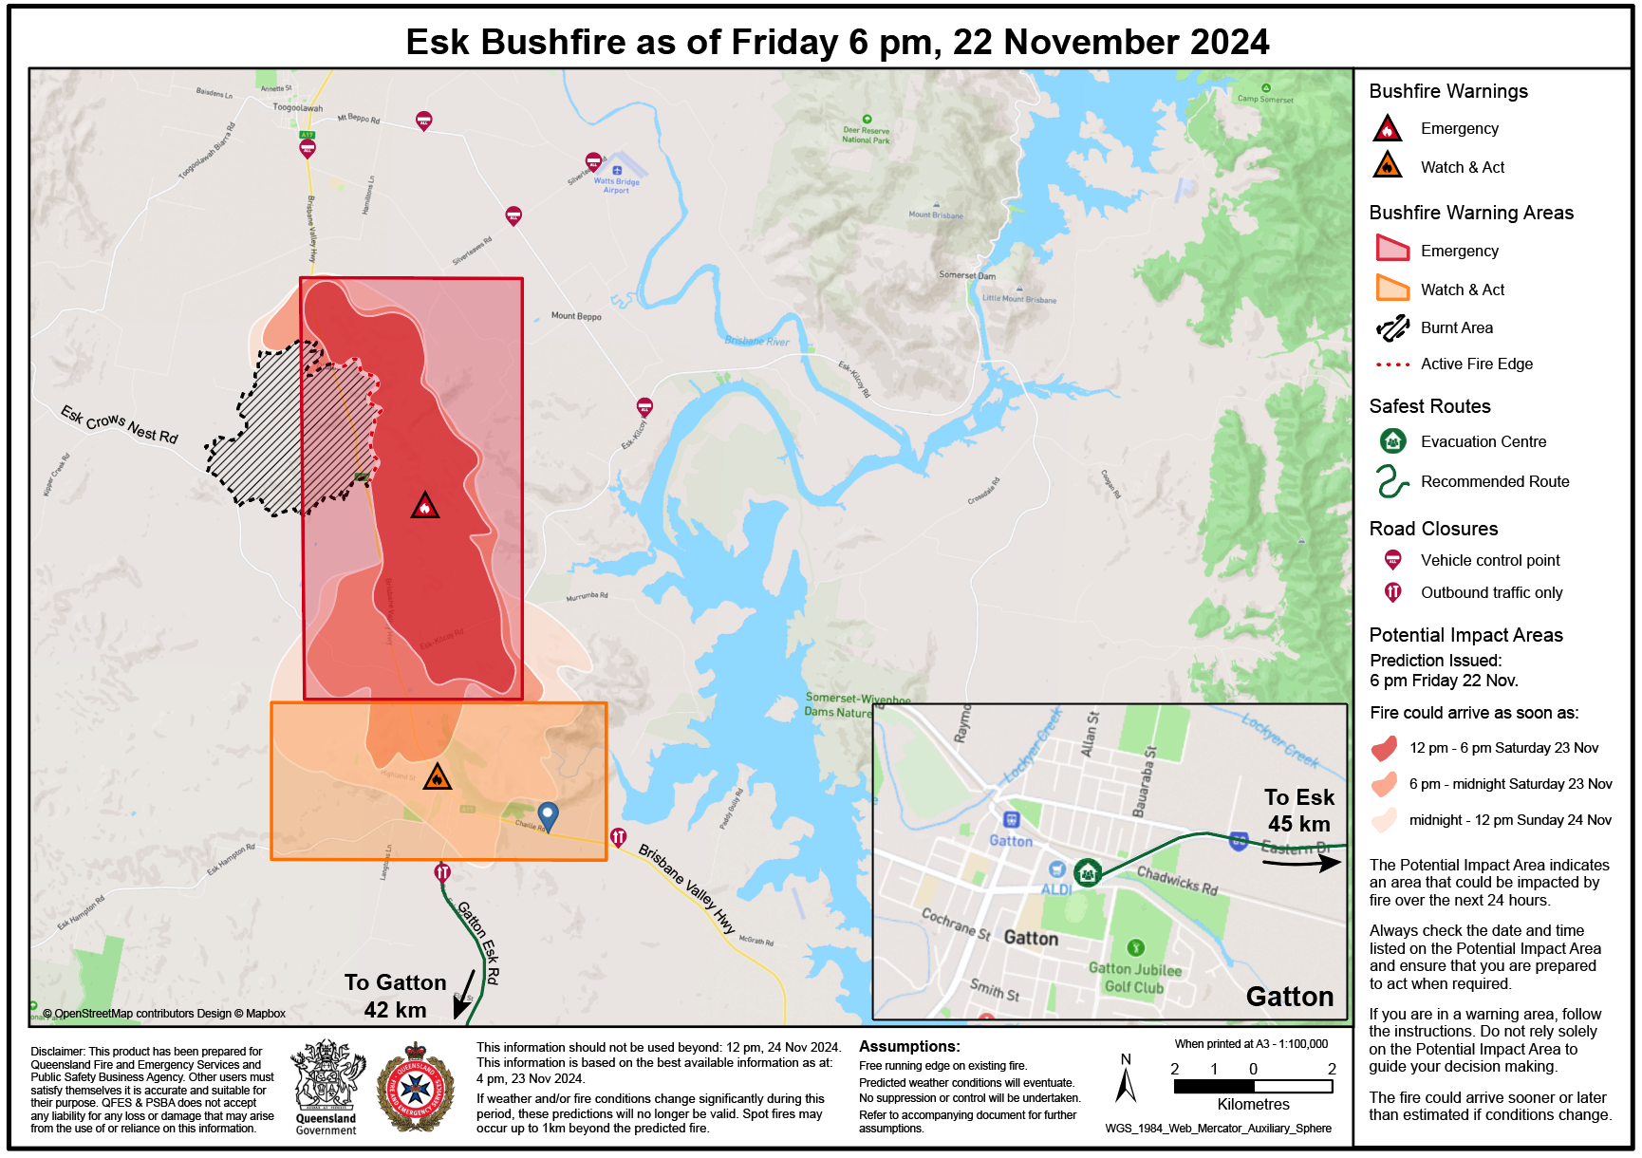
Next steps
Principles 2, 3, 4
Phase Two continues:
Work Package 8 Focus Groups
South Australia
Queensland
Western Australia
Directionality of hazard: use arrows showing directionality of the bushfire spread.
Legend: use a legend or key to help interpret the information presented on the map.
Timing: indicate when the map was developed and for how long it is valid; time estimates on how fast it is tracking.
Landmarks: show on the map key landmarks, including evacuation centres, to help people locate themselves on the map.
Routes: show clear routes out to help people navigate their evacuation.
Interactive capabilities: provide the ability to engage with the map directly, i.e., zoom functionality.
Sizing and legibility: increase the prominence of hazard markers alongside placenames, roadways, and other landmarks.
Colours: increase contrast of colours to clearly delineate multiple warning areas.
Notes:
The findings from this work package (WP9) have been shared with the Steering Committee across three separate sessions ranging 30-60minutes. During these sessions, the Steering Committee were able to interrogate, validate, and interpret the findings as the report was being prepared. As a consequence of the series of sessions, a Decision Paper (see Appendix B) was developed to determine which elements from Phase 1 and Phase 2 thus far will be brought into the design of fire spread prediction maps for both the community focus groups (WP8) and eye-tracking experiments (WP10).
The Decision Paper was presented and discussed in an additional session with the Steering Committee to collaboratively decide on which elements of the design to test including but not limited to: layering of fire spread prediction maps and incident warning maps, colours to be used on the fire spread prediction maps, whether to include directionality, the size of the polygons of both incident and fire spread prediction maps, were to locate the participants on the map, and what base map to use. Additionally, the paper asked for collaborative input on questions to future study participants on the burnt area, legend, evacuation routes, and road closures.
The designs tested in the upcoming work packages (WP8 and WP10) will then subsequently inform the best practice design of a fire spread prediction map for additional testing in another national survey (WP12) and interviews with specific community groups (e.g., CALD community) (WP11).

Slide 29
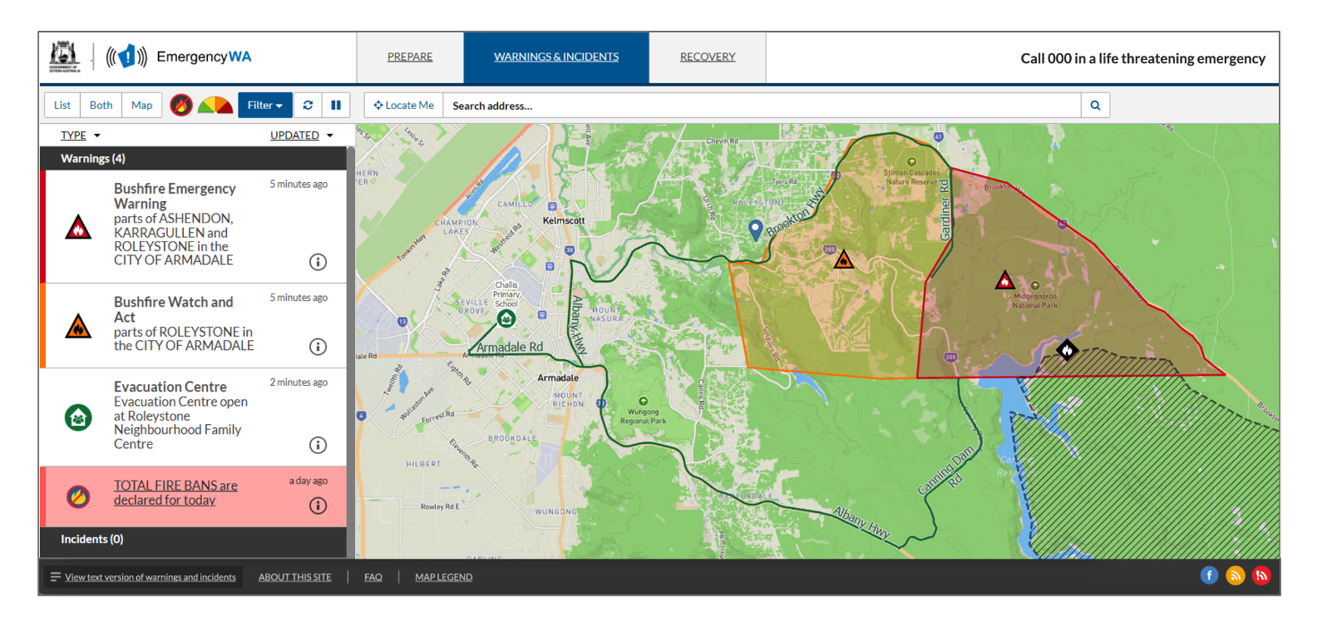
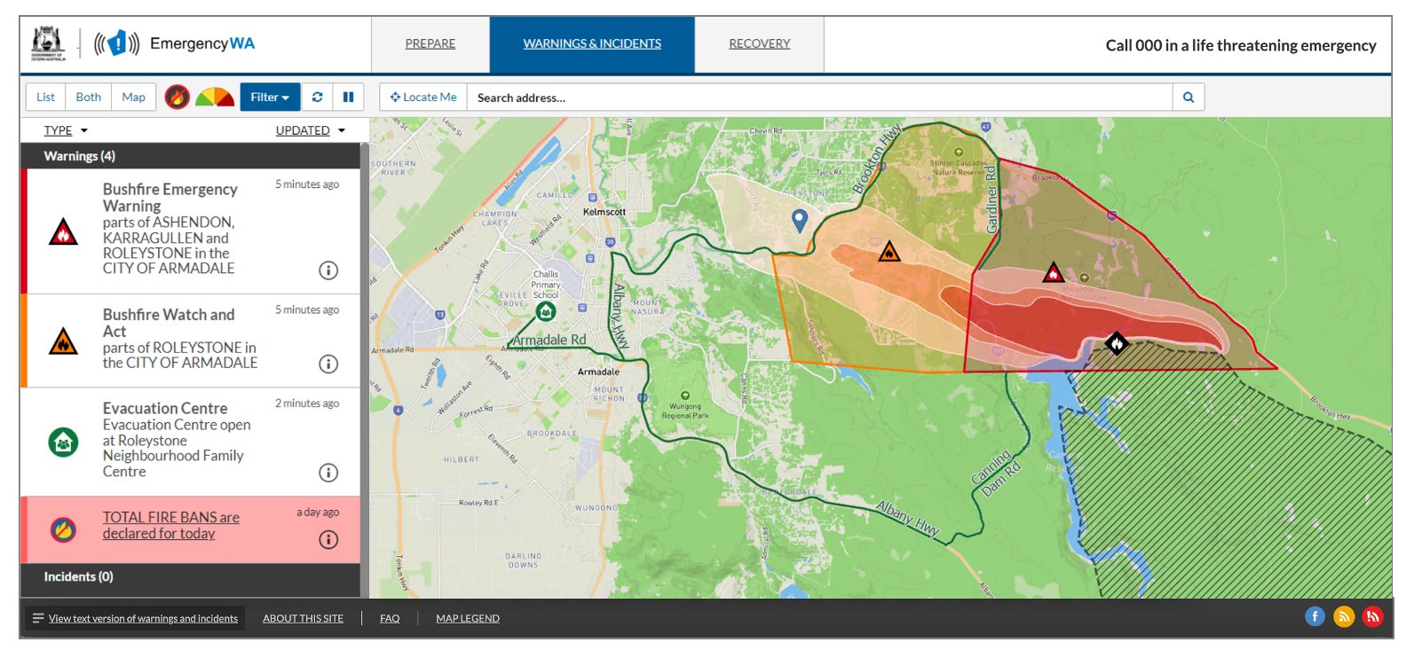
Next steps
Principles 2, 3, 4
WP 10 eye tracking experiments
WA (scenario-based experiment):
Experiment with five time points & associated maps as a fire event progresses.
Do people with the prediction make a protective action decision more quickly?
Design features
interaction between warning areas & predictions
role of interactivity (zooming, panning, clicking for more information)
inclusion of evacuation route information
how much do people focus on publication/validity time information?

Slide 30
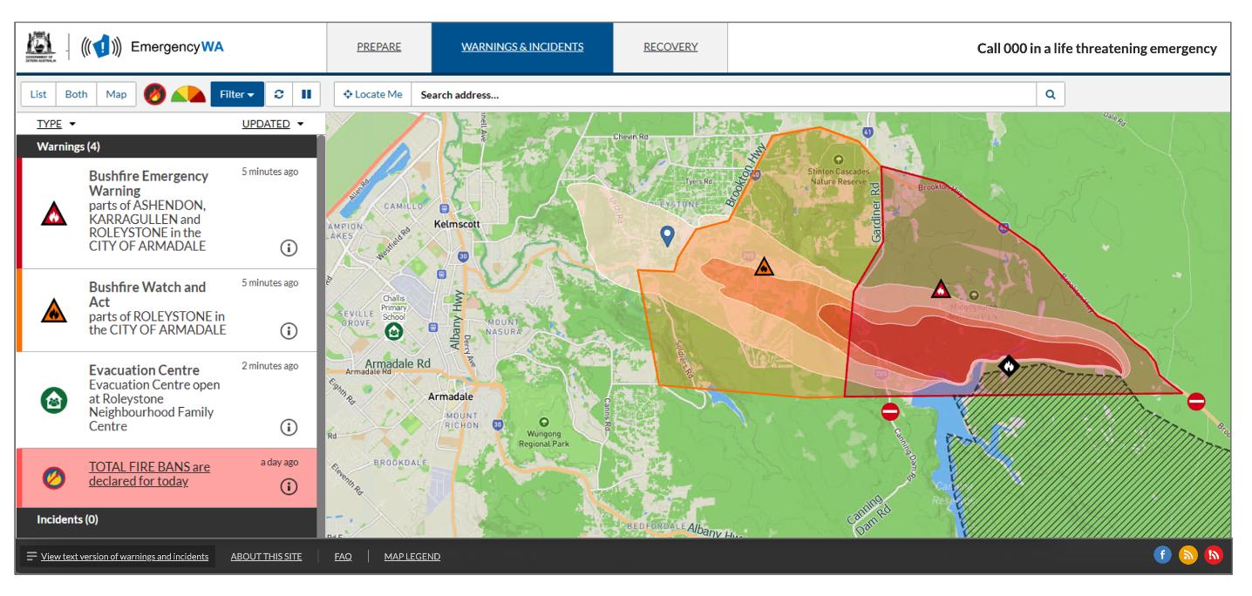
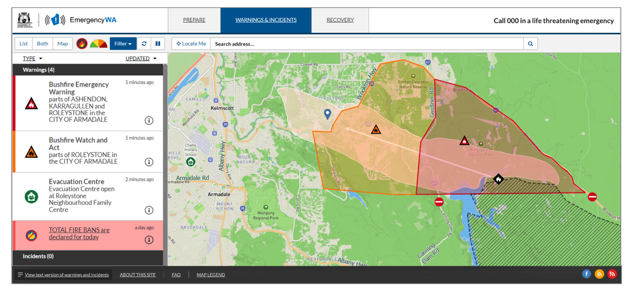
Next steps
WP 10 eye tracking experiments
VIC (scenario-based experiment):
Experiment with five time points & associated maps as a fire event progresses.
Are there differences in when people take protective actions? Does one design produce quicker (appropriate) decisions?
Design features
Temporal precision of prediction --> comparison of one isochrone (24 hrs) vs 3 isochrones (0-6, 6-12, 12-24 hrs)
Shows road closures, not evacuation routes
3 isochrone map's findings can be compared with WA study findings to shed light on differences produced by showing evacuation routes vs road closures.

Slide 31
Next steps
Phase Two continues:
2025: interviews (WP11), national survey (WP12)
Phase 3: translation into agency policy and practice --> practical outputs (2025)

Slide 32
PREDICTIONS IN PUBLIC
A QUANTITATIVE UNDERSTANDING OF COMMUNITY MEMBERS' COMPREHENSION AND USE OF BUSHFIRE.
Dr Amy Griffin
Senior Lecturer
RMIT University
Natural Hazards Research Australia
amy.griffin@rmit.edu.au
Dr Paula Dootson
Associate Professor
Queensland University of Technology
Natural Hazards Research Australia
paula.dootson@qut.edu.au
Deana Pullella
Team Leader Public Information | Media and Corporate Communications
Department of Fire and Emergency Services, Western Australia
deana.pullella@dfes.wa.gov.au
© Natural Hazards Research Australia 2023
Notes:
Acknowledgement
Thank SteerCo

